Slide 1
Physiological Role of Stress

Slide 2
Learning Objectives
Describe the physiological mechanisms of chronic and acute stress responses
Explain how physiological changes associated with stress can are linked to appetite, fat mobilization and diabetes
Understand the relationship between endogenous mediators of stress and commonly prescribed glucocorticoid medications
Evaluate the role of weight stigma and chronic stress in obesity
Describe the links between adverse childhood events on the risk of obesity

Slide 3
Inducers of Stress

Slide 4
What is stress?
Take a few minutes reflecting on things that cause stress, and how you respond to it?

Slide 5
Some Common Sources of Stress
Intrinsic
Extrinsic
Sleep quality
Self-actualization
Chronic Illness
Social isolation
Neighborhood safety
Conflict
Work demands
Food insecurity
Lack of social support

Slide 6
Effects of adverse childhood experiences on obesity
Some traumatic events
Poor parenting
Divorce
Poor mental health
Chronic illnesses in family
Domestic violence
Child abuse

Slide 7
Physiological Responses to Stress

Slide 8
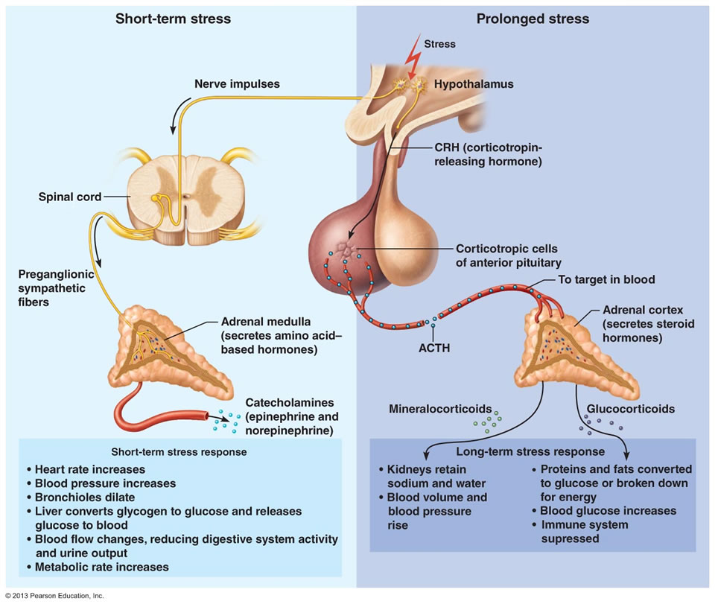
Adrenaline and Cortisol are Stress Hormones
Adrenaline
Blood presure/heart rate
Bronchiodilation
Reduced digestion
Cortisol
Appetite
Increased blood glucose
Proteins/Fat broken down
Notes:
Talk about initial effects of stress, diverting energy away from food seeking behavior
Ongoing stressful events need more food

Slide 9
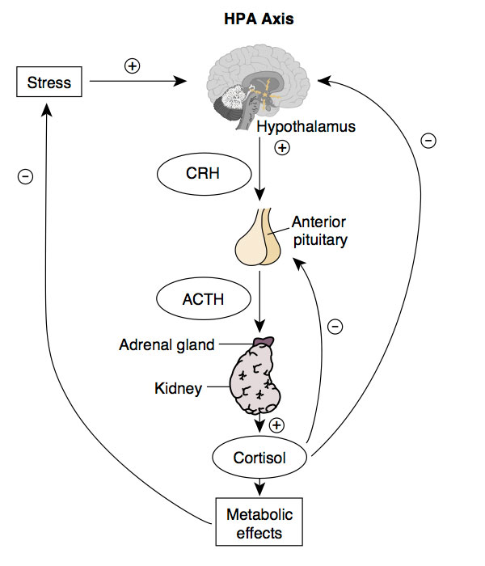
The Hypothalamic-Pituitary Adrenal (HPA) Axis

Slide 10
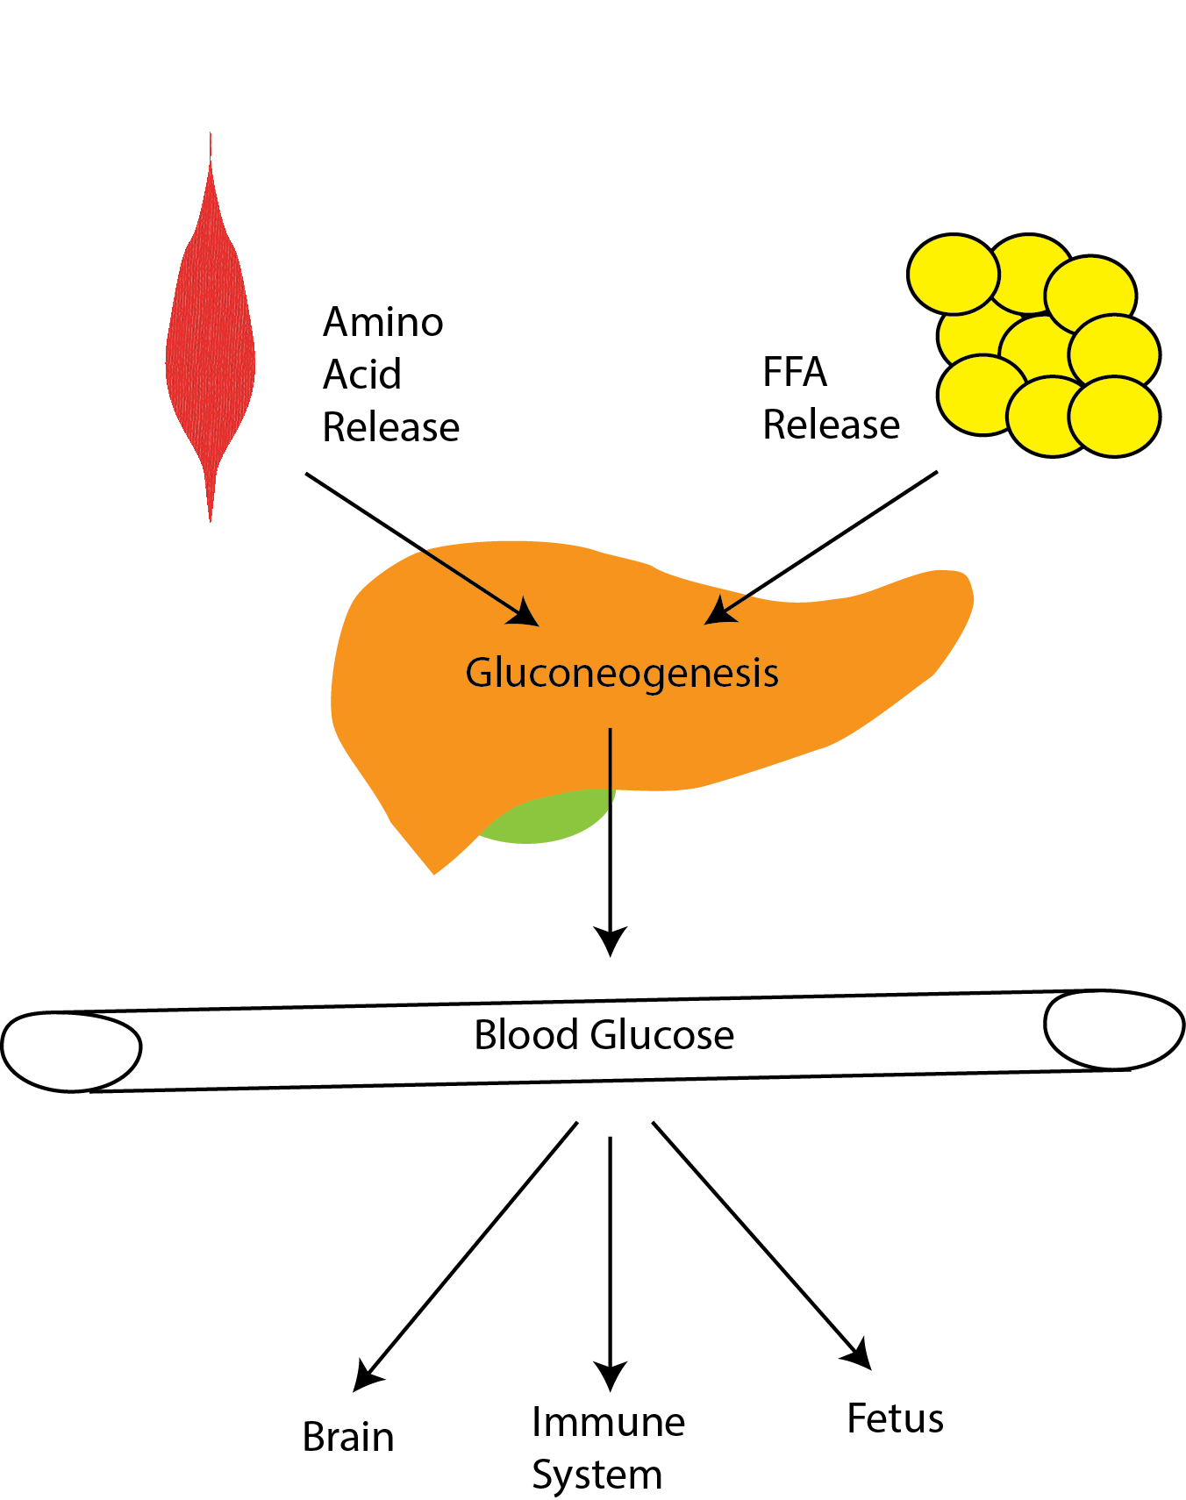
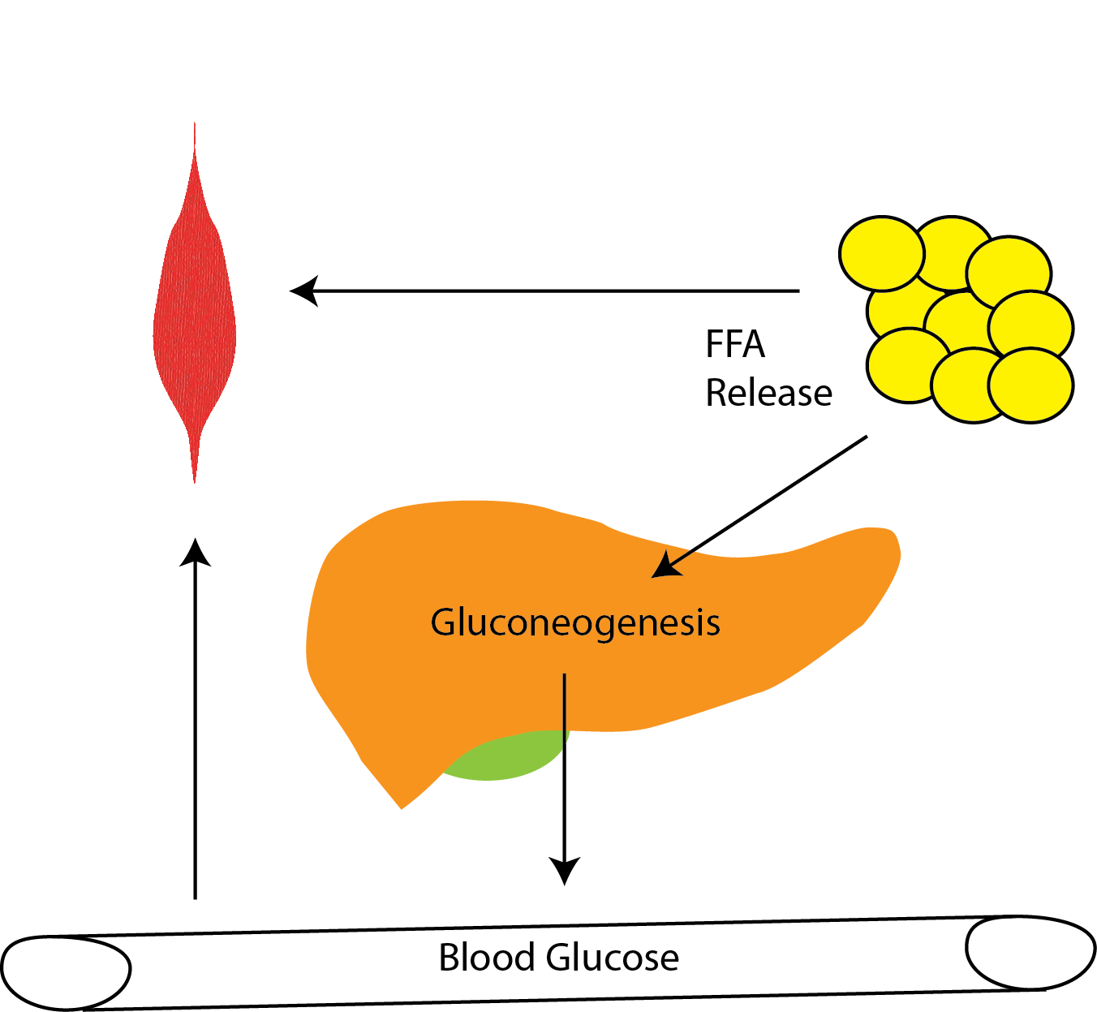
Metabolic Roles of Stress Hormones
Cortisol
Epinephrine
Notes:
Discuss similarities and differences between cortisol and epinephrine.
Spend some time, talking about why these differences exist

Slide 11
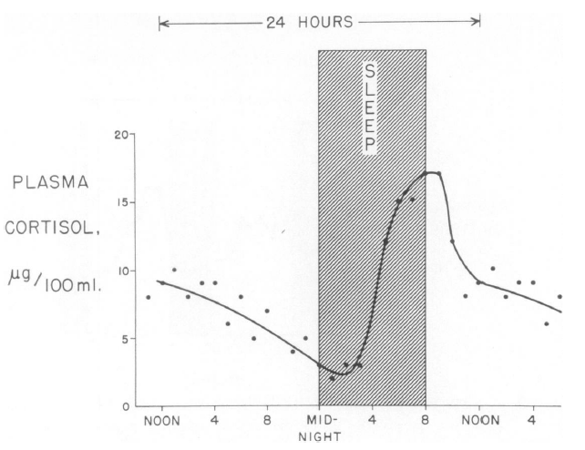
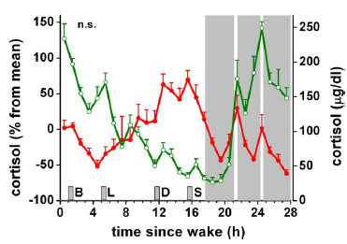
Cortisol levels fluctuate over the day
Normal
Sleep disrupted
Liddle GW (1966) An analysis of circadian rhythms in human adrenocortical secretory activity. Trans Am Clin Clim Assoc 77: 151–160.
Scheer F AJL, Hilton MF, Mantzoros CS, Shea S A (2009) Adverse metabolic and cardiovascular consequences of circadian misalignment. Proc Natl Acad Sci U S A 106: 4453–4458. doi:10.1073/pnas.0808180106.
Notes:
Fedex workers

Slide 12
Physiological effects of cortisol
Increased blood glucose
Muscle breakdown (weakness)
Fat redistribution
Increased liver fat
Increased sensitivity to adrenaline
Increased appetite

Slide 13
Cortisol and Eating

Slide 14
Effects of Chronic Stress on Appetite
Effects on energy expenditure mediated by reductions in muscle
Stress or prescribed glucocorticoids have a strong hyperphagic effect
Response to injected Corticotropin Releasing Hormone (CRH) in humans

Slide 15
Effects of Glucocorticoids on Eating Behaviors
Chow
Increased CORT increases intake of lard (“calorie dense) but not chow (”healthy”)
Lard
Increasing CORT
Notes:
Participants entered a room, said there were leftover snacks. They were asked to solve either a solvable (unstressed) or unsolvable anagram (stressed)

Slide 16
Variations in Stress Responses
Men: 33.9% ate more food
Women: 55% ate more food
During Exam
After Exam
Notes:
Females report hyperphagia for sweets and chocolate
Dieters were more likely to report hyperphagia for breads

Slide 17
Associations between Stress and Weight Stigma
COBWEBS model: cyclic obesity/weight-based stigma
Think of some strategies for breaking this cycle
Weight loss
Exercise
Self-perception of body weight
Acceptance interventions
Notes:
COBWEBS model
Acceptance interventions such as healthy at any size Exercise reduces stress, but stigma is associated with exercise avoidance

Slide 18
Learning Objectives
Describe the physiological mechanisms of chronic and acute stress responses
Explain how physiological changes associated with stress can are linked to appetite, fat mobilization and diabetes
Understand the relationship between endogenous mediators of stress and commonly prescribed glucocorticoid medications
Evaluate the role of weight stigma and chronic stress in obesity
Describe the links between adverse childhood events on the risk of obesity

